Slide 1
2. Benefits of Organization
Topic 1. What is a Business?
Chapter 1. Business Basics.
Unit 1. The Context of Business.
MXA101 – Introduction To Business
-By ManageX Academy

Slide 2

Meaning of Organization
Group of individuals and teams
Working towards common goals
Coordinated efforts
Planned structure

Slide 3
Organization and Business Success
Clear focus on goals
Better coordination
Smooth operations
Long-term success

Slide 4
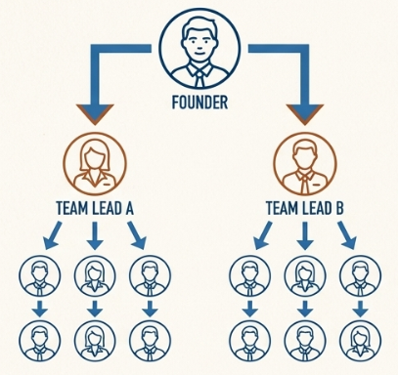
Division of Labor
Work divided into tasks
Responsibility assigned
Reduces workload
Improves speed

Slide 5
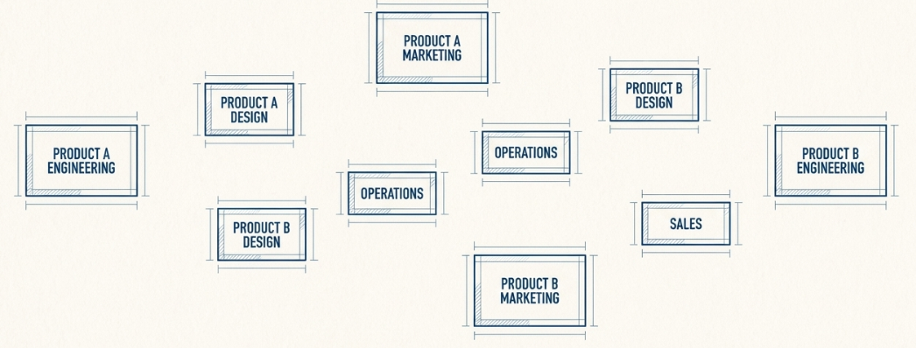
Specialization
Expert handles specific task
Higher quality output
Skill-based roles
Professional growth

Slide 6
Organization Structure and Growth
Supports expansion
Determines resource needs
Defines reporting relationships
Enables scalability

Slide 7
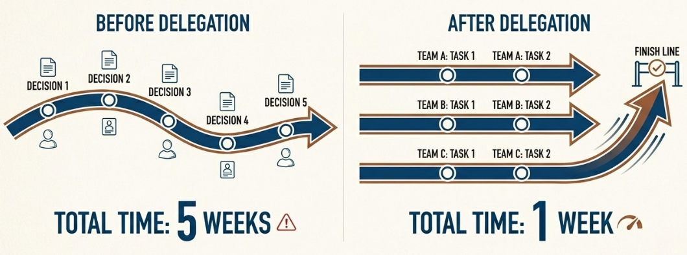
Efficiency in Organization
Optimal use of resources
Saves time and cost
Reduces wastage
Improves productivity

Slide 8
Delegation of Authority
Transfer of responsibility
Faster decision-making
Employee empowerment
Organizational flexibility

Slide 9
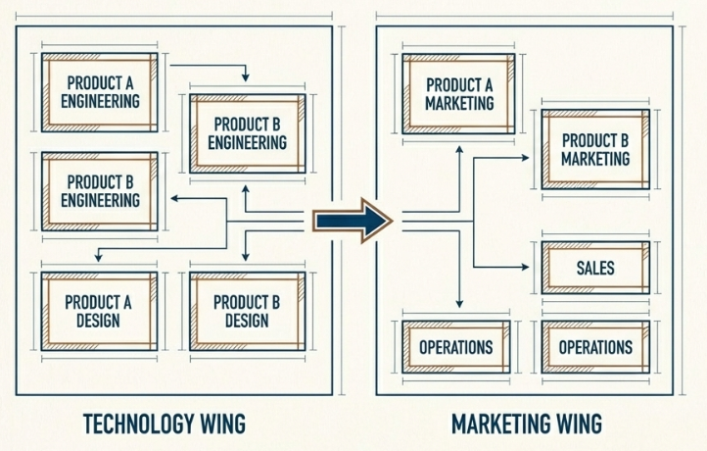
Departmentalization
Grouping of activities
Better coordination
Parallel work possible
Clear accountability

Slide 10
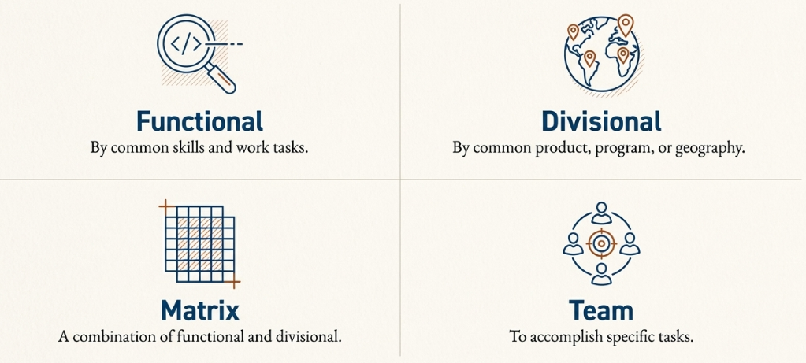
Types of Departmentalization
Functional
Divisional
Matrix
Team-based
Network structure

Slide 11
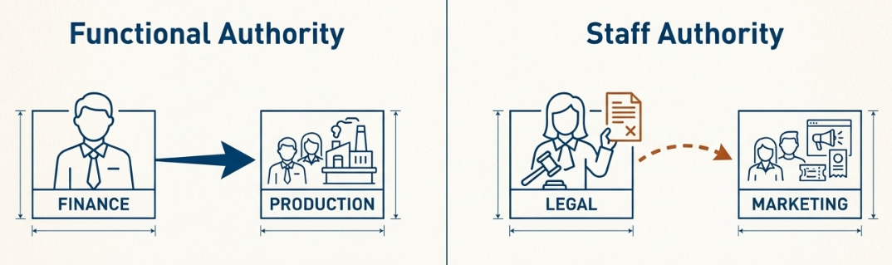
Functional Authority Example
Specialized decision power
Advisory or control role
Supports compliance
Reduces risk

Slide 12
Organization and Goal Orientation
Aligns individual goals
Achieves organizational objectives
Ensures continuity
Supports diversification

Slide 13
Key Benefits Summary
Better coordination
Higher efficiency
Faster decisions
Sustainable growth

Slide 14
Conclusion & CTA
Organization is backbone of business
Essential for success
Foundation of management

Slide 15


